Slide 1

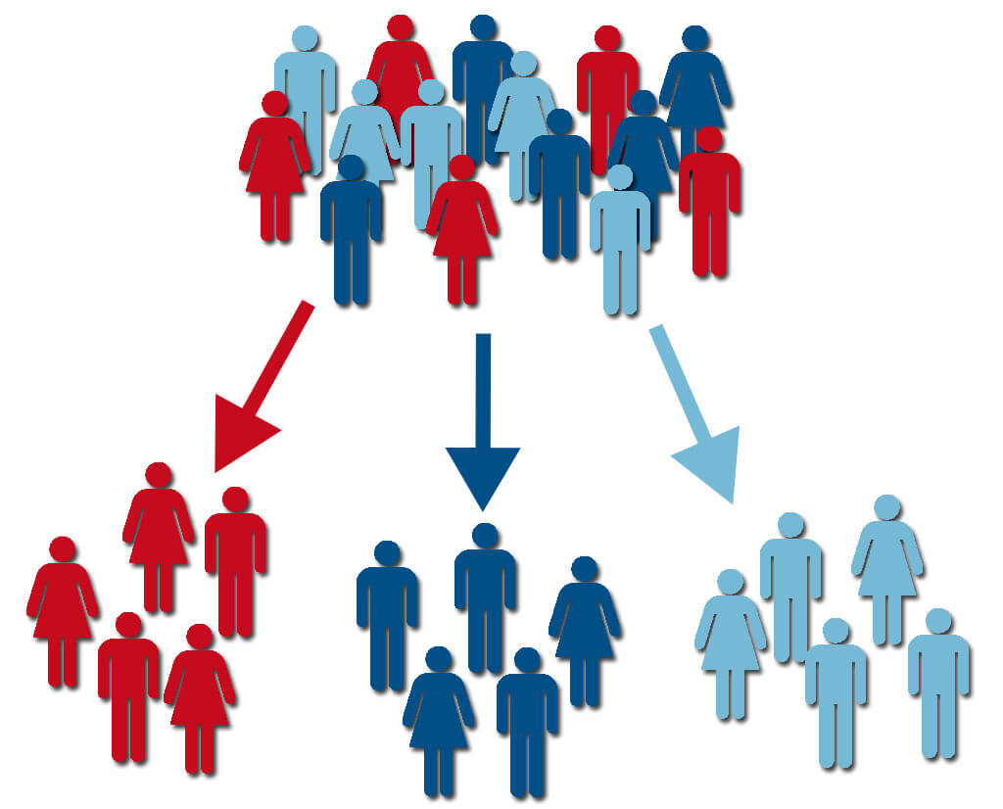
CUSTOMER SEGMENTATION: ON BASIS OF CRISA-BATHSOAP DATA
Created by: Sumit Dutt Mishra
Submitted to : Dr. Murali Shanker

Slide 2
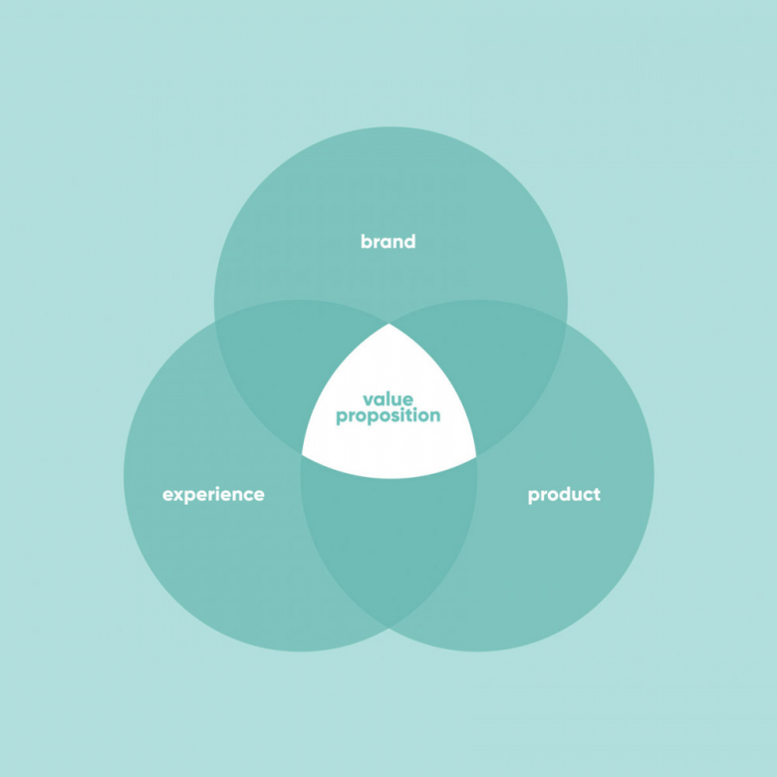
PROPOSITION OF BUSINESS
What customers should get depending on loyalty to brand:
Loyal Customers: Discounts on products: They should get discounts for being loyal
Updates on Fresh Arrivals: There are high chances that they will buy the latest products. Thus should be notified regularly
Disloyal Customers: Exposure to brands: Provide proper advertisements so that they can choose the perfect product
Promotional offers on brands: Motivating them by giving promotional offers

Slide 3

SEGMENTATION OF CUSTOMERS
SEGMENT 1: Customers have high purchase cost.
SEGMENT 2: Customers with typical family.
SEGMENT 3: Spends in Extravagant way and are loyal to brand
SEGMENT 4: Unresponsive to Advertisements and Promotions of Brands

Slide 4
Recommendations for increasing brand loyalty and generating higher revenue
SEGMENT 1: Normal Pricing , advertisement on products with low price , discounts and offers on products.
SEGMENT 2: Advertisements and Discounts on products and offers on products.
SEGMENT 3: Advertisements and Promotions of high priced products and offers.
SEGMENT 4: Provide good promotions of different variety of products giving them exposure to different segments and providing offers on various products.

Slide 5

THANK YOU

